Slide 1
Phishing attack Awareness
Abdelrahman ibrahim

Slide 2
AGENDA
1-what is phishing attack?​
2-phishing attack techniques.
3-famous phishing attacks in history.
4-How to prevent Phishing Attacks?
​

Slide 3
What is phishing attack?

Slide 4
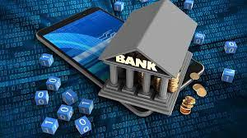

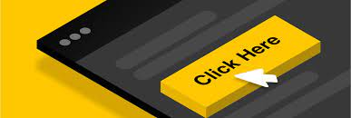
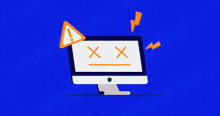
Mark is relaxing at home, when he received an email from his bank, informing him to update his credit card pin
Mark follows the link in the email and delivers his current pin and the updated one.
After he updated the pin code the website crashes.

Slide 5

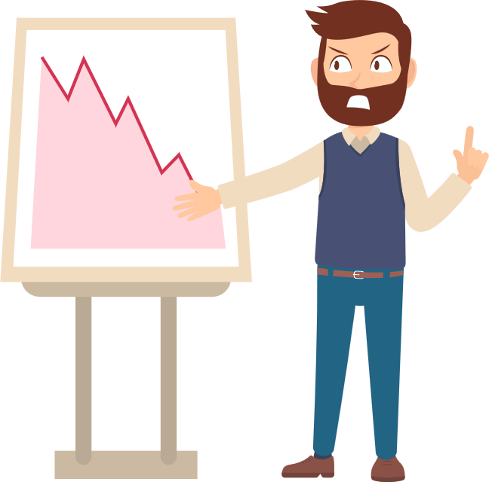
After a couple of hours he noticed a significant purchase from a random website he never authorized !!
-30000$
This is a classic example of phishing

Slide 6
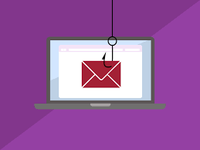
Phishing attacks are a type of cyber attack where attackers trick individuals into revealing sensitive information, such as passwords, credit card numbers, or personal details. It typically involves sending deceptive emails, text messages, or creating fake websites that appear to be from legitimate sources, such as banks, social media platforms, or online services.

Slide 7
Phishing attack techniques.

Slide 8
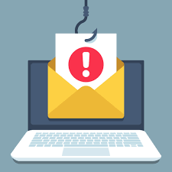
Here are some common phishing attack techniques:
(1)Email Phishing: Attackers send deceptive emails that appear to be from legitimate organizations, such as banks, social media platforms, or online services. The emails usually contain urgent or enticing messages, encouraging recipients to click on malicious links or provide their personal information.
`

Slide 9
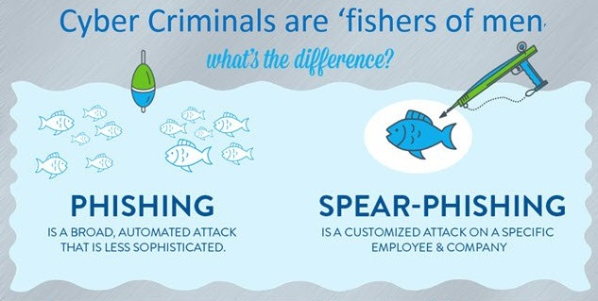
(2)Spear Phishing: This technique involves highly targeted phishing attacks where attackers gather specific information about an individual or organization to personalize the phishing attempt. They may use information like the recipient's name, position, or recent activities to increase the chances of success.

Slide 10

(3)WHALING: Whaling is a type of phishing attack that specifically targets high-profile individuals, such as executives or CEOs. Attackers aim to trick these individuals into divulging sensitive corporate information or performing actions that can lead to financial loss or compromise.

Slide 11
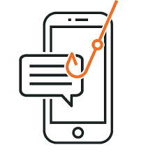
(4)SMISHING: In smishing attacks, attackers use text messages (SMS) to deceive recipients into taking action or providing personal information. The messages often impersonate legitimate organizations and may contain malicious links or phone numbers to call.

Slide 12
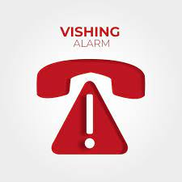
(5)VISHING:Vishing (voice phishing) attacks involve attackers making phone calls to individuals, pretending to be from trusted organizations. They use social engineering techniques to manipulate victims into revealing sensitive information over the phone.

Slide 13

(6)PHARMING: In pharming attacks, attackers manipulate the DNS (Domain Name System) system or compromise routers to redirect users to fraudulent websites without their knowledge. Victims are then tricked into entering their credentials or personal information on these malicious sites.

Slide 14
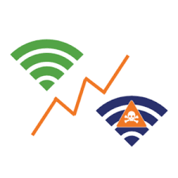
(7)EVIL TWIN ATTACKS: In Wi-Fi environments, attackers set up malicious access points that mimic legitimate networks. When users connect to these networks, the attackers can intercept their traffic and collect sensitive information.

Slide 15
famous phishing attacks in history.

Slide 16
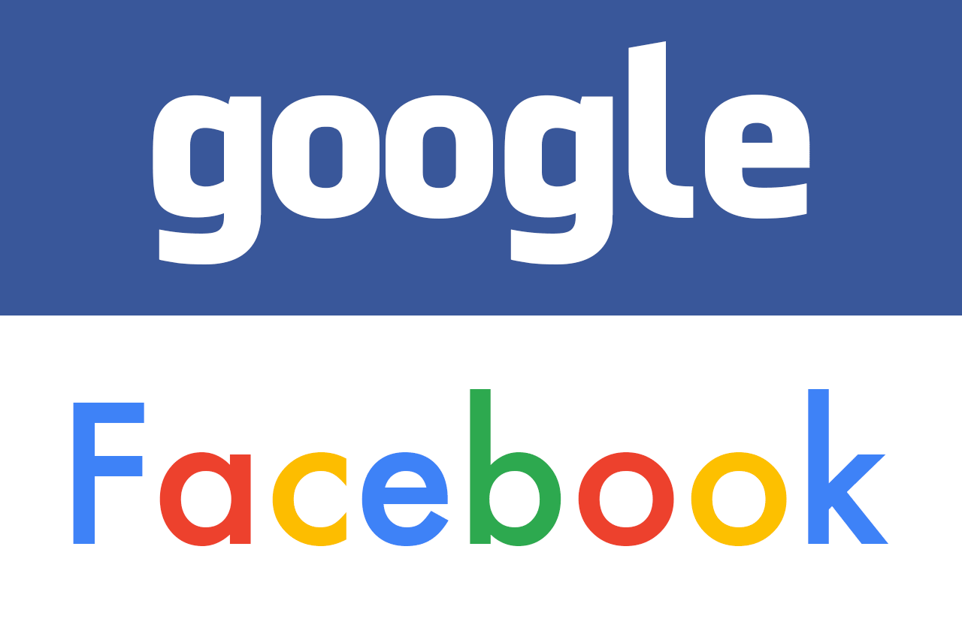
Facebook & Google
This is a huge one. Two of the world's largest tech giants, Facebook and Google, lost $100 million in this single email scam from Lithuania. While an arrest was made, the story shows that even the most advanced tech entities are susceptible to phishing attacks.

Slide 17

2018 World Cup
The Federal Trade Commission released this statement regarding phishing attempts during the 2018 World Cup in Russia. The scam claimed the victim won tickets to the World Cup through a lottery and prompted them to enter their personal information to claim the prize.

Slide 18

The Sony Pictures Leak
2014 also saw a huge data leak from Sony. Over 100 Terabytes containing confidential company activities were breached, resulting in well over $100 million lost. The phishers pretended to be colleagues of the top-level employees who opened the malicious attachments in the phishing emails.

Slide 19
How to prevent phishing ?

Slide 20
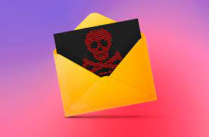

To prevent falling victim to phishing attacks, here are several effective measures you can take:
Be cautious with email:
Exercise caution when receiving emails, especially from unknown senders or emails that seem suspicious. Look out for signs of phishing, such as spelling or grammatical errors, requests for sensitive information, urgent or threatening language, or generic greetings.
`

Slide 21
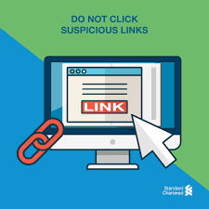
(2) Don’t click on suspicious links :
Don't click on suspicious links: Avoid clicking on links in emails, text messages, or instant messages from untrusted or suspicious sources. Instead, manually type the URL of the website you want to visit or use bookmarks to access trusted websites.

Slide 22

(3) Verify the source:
Before clicking on any links or providing personal information, verify the authenticity of the sender. Check the email address to ensure it matches the official email addresses of the organization. When in doubt, contact the organization directly through their official website or phone number to confirm the legitimacy of the communication.

Slide 23
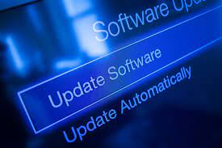
(4) Keep software up to date:
Regularly update your operating system, web browsers, and other software to ensure you have the latest security patches. Attackers often target vulnerabilities in outdated software to exploit users.

Slide 24
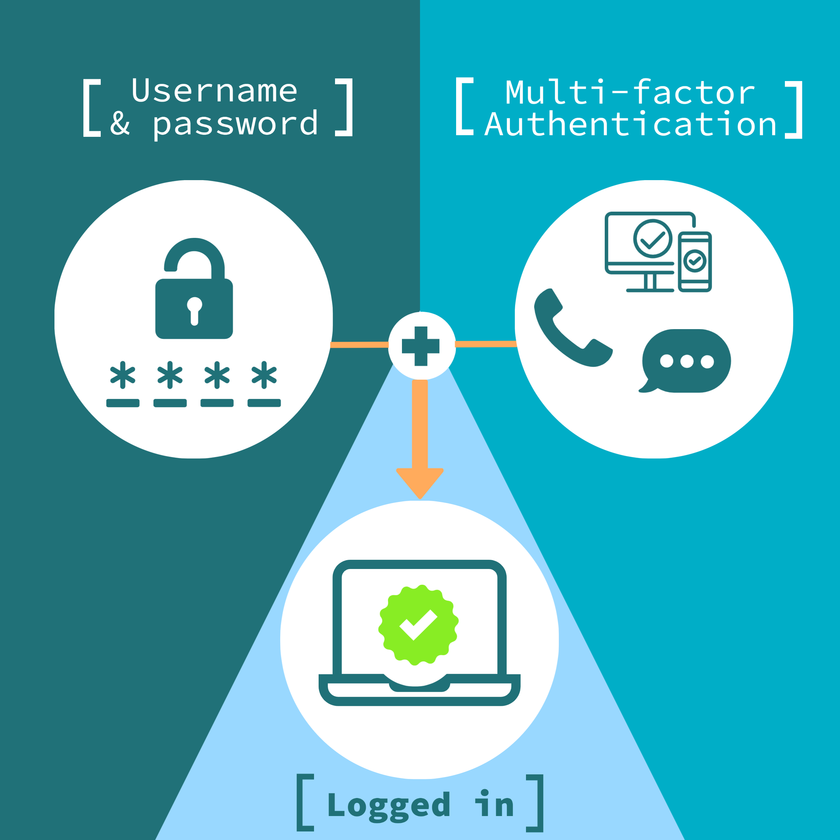
(5) Enable multi-factor authentication (MFA): Enable MFA whenever possible on your online accounts. MFA adds an extra layer of security by requiring an additional verification step, such as a fingerprint scan, text message code, or authenticator app, in addition to your password.

Slide 25
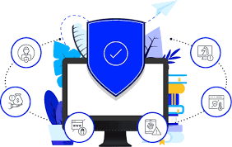
(6) Use anti-phishing tools and software: Consider using anti-phishing tools and software that can help detect and block phishing attempts. These tools can identify and warn you about potentially malicious websites or emails.

Slide 26

(7) Educate yourself and others: Stay informed about the latest phishing techniques and educate yourself and your colleagues about the risks and best practices. Regularly provide security awareness training to help users recognize and respond appropriately to phishing attempts.

Slide 27
THANK YOU

